Slide 1
GIT&GITHUB
Git is a software. Git is installed locally on the system Git is maintained by Linux. Git is a version control system to manage source code history. The purpose of Git is to manage a project, or a set of files, as they change over time. Git stores this information in a data structure called a repository. A git repository contains, among other things, the following: A set of commit objects. | GitHub is a service. GitHub is hosted on the web GitHub is maintained by Microsoft. GitHub is a hosting service for Git repositories. GitHub is a Git repository hosting service, but it adds many of its own features. While Git is a command-line tool, GitHub provides a Web-based graphical interface. It also provides access control and several collaboration features, such as wikis and basic task management tools for every project.

Slide 2
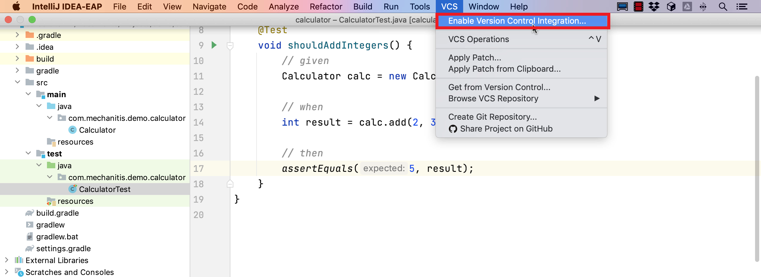

Slide 3
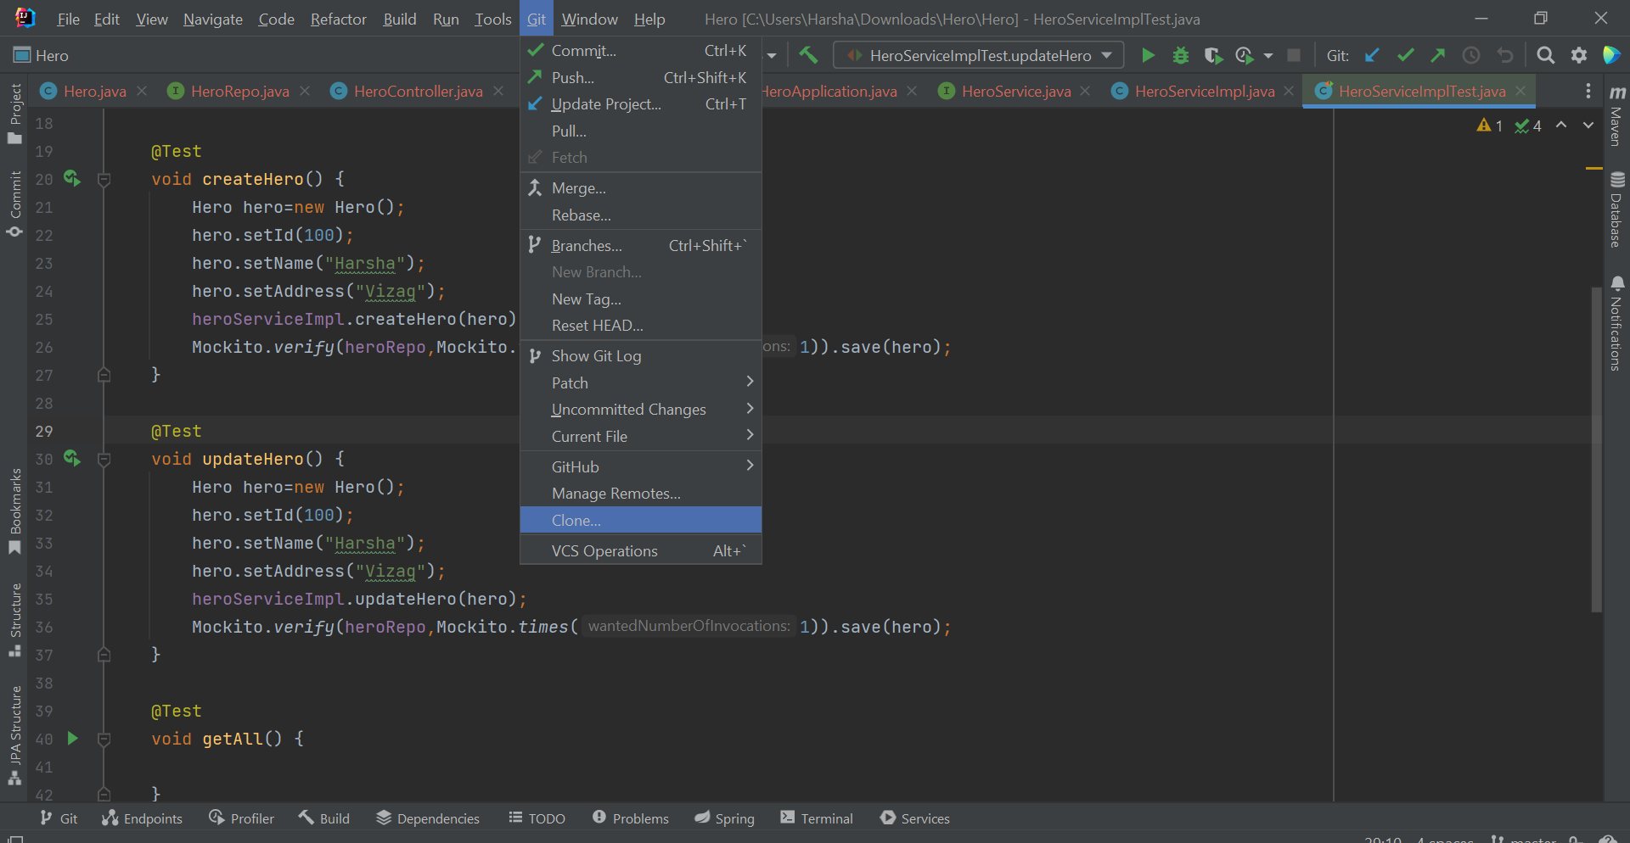
1.Afetr Enabling Version Control Integration, you able to see Option as GIT in IntelliJ. 2. Go to GIT and under GIT use option CLONE.

Slide 4
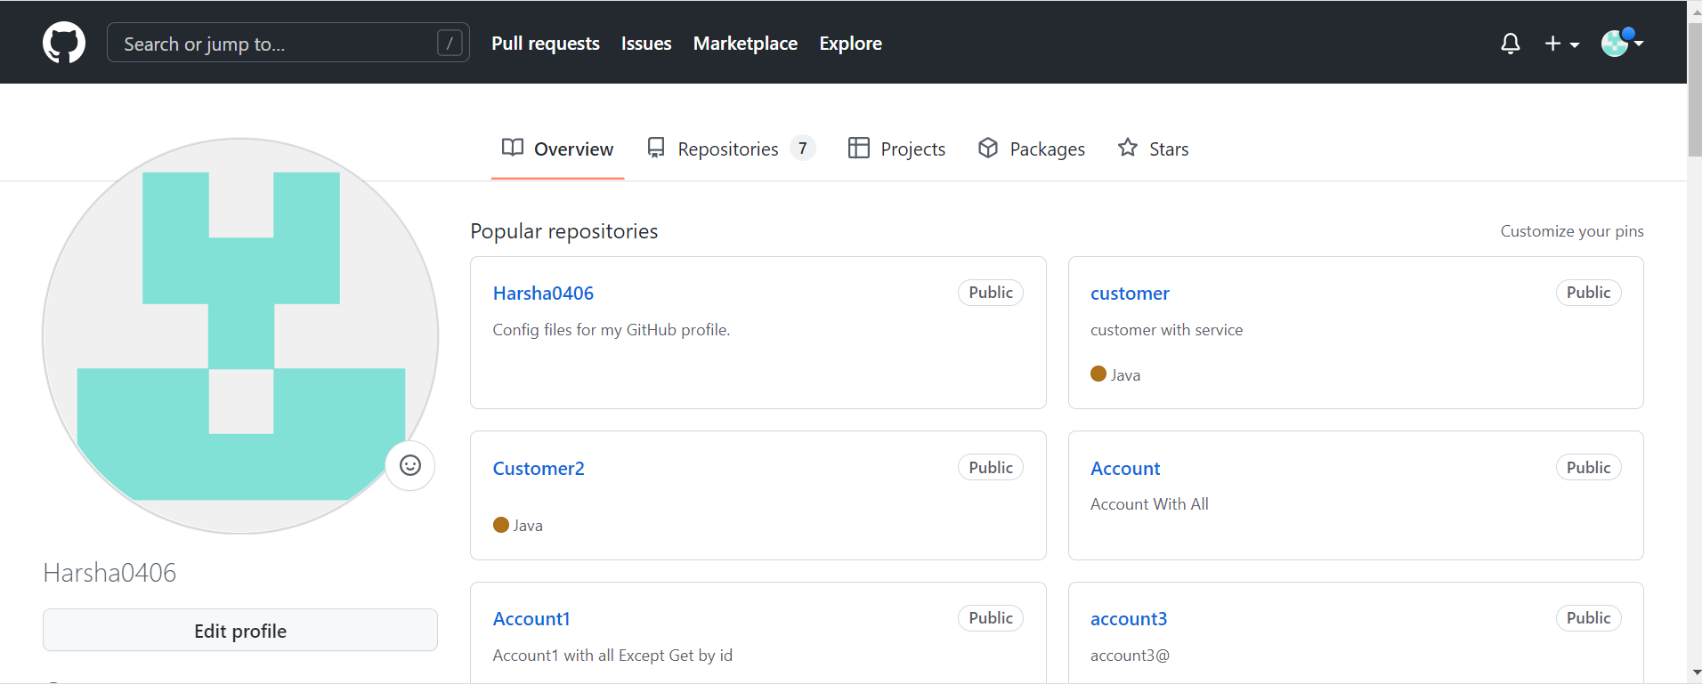
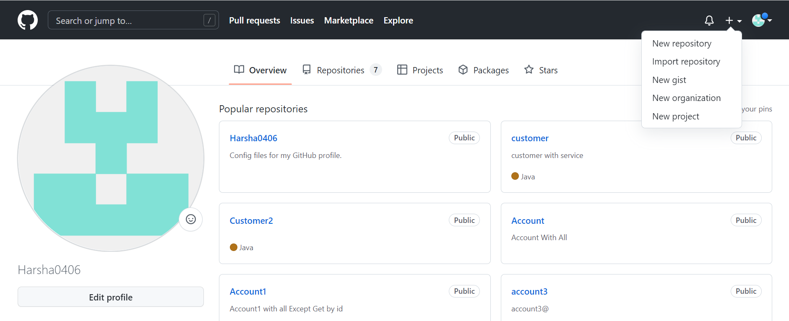
1. After Entering URL, go to Chrome and Sign In to GITHUB. 2. The Window will Open as Below. 3. Go to Right Hand Upside Corner and click on + symbol to add New Repository.

Slide 5
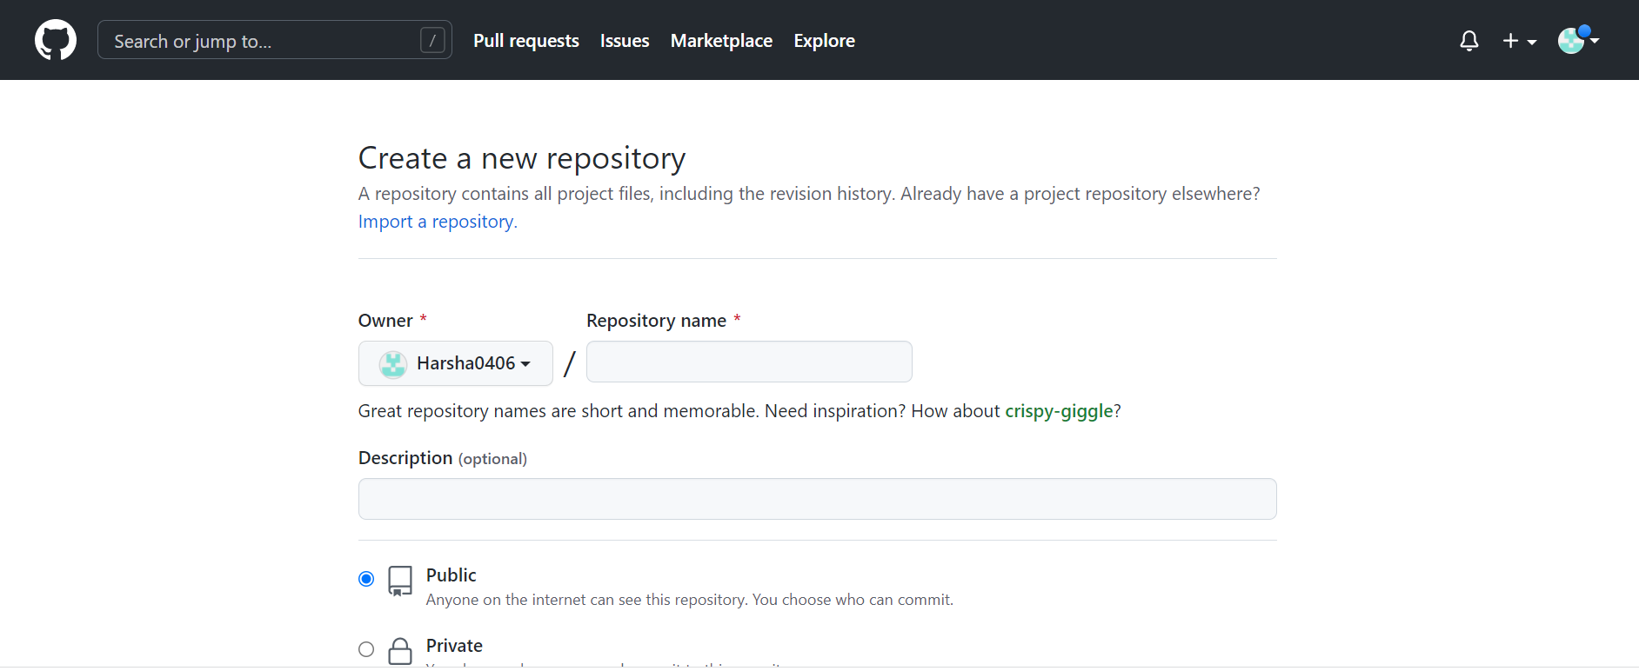
1. Give Repository Name. (What Kind of Program you had done in IntelliJ.) E.g. Customer, Student, Employee etc. 2. Give Description as you like about what type of Program for Better Understanding. (It’s Optional.)

Slide 6
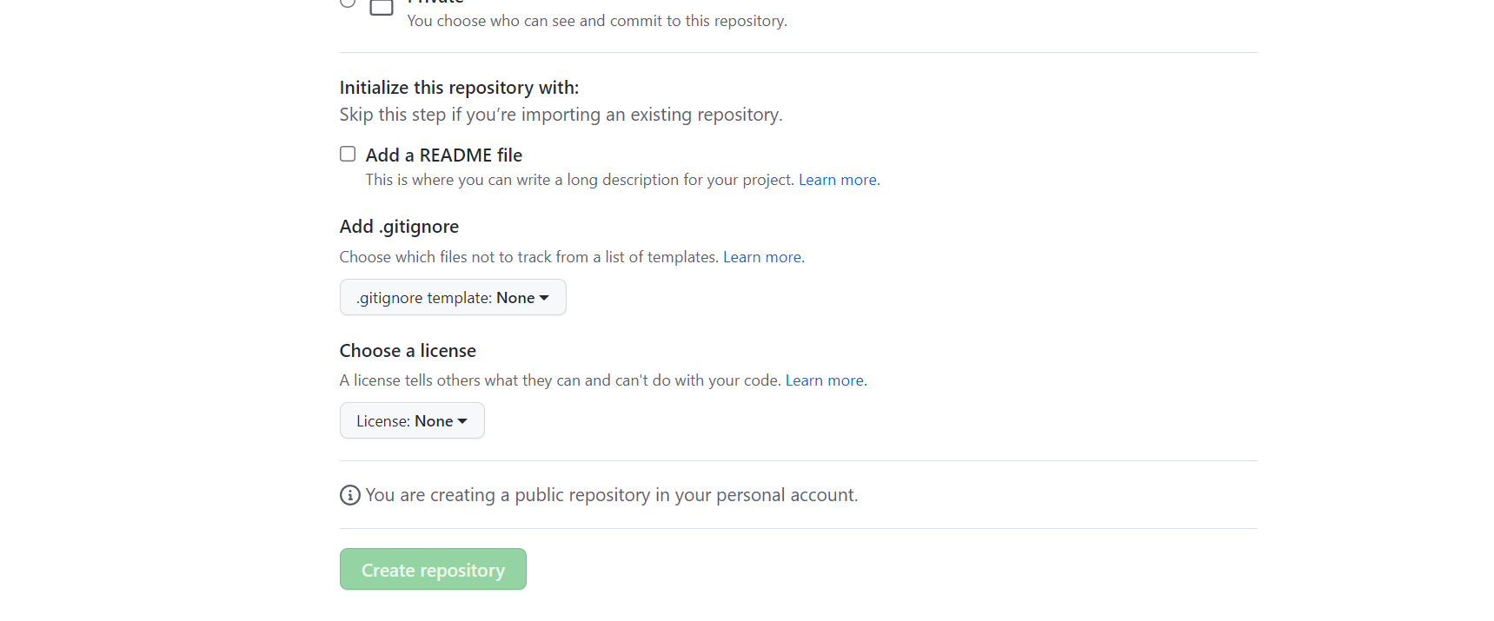
After Giving Repository Name & Description, go to down and click on Create repository.

Slide 7
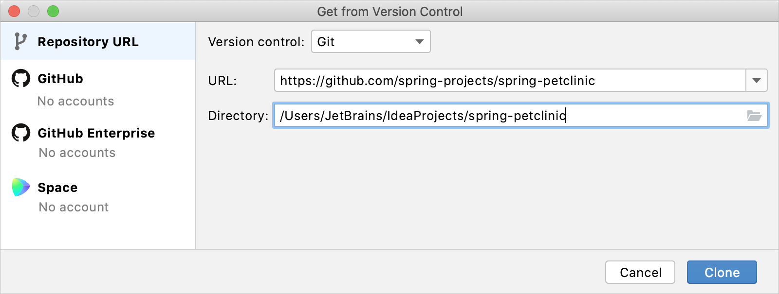
After Creating Create REPOSITORY you will get the URL on next window. Copy that URL and paste it in Git and Clone it.

Slide 8
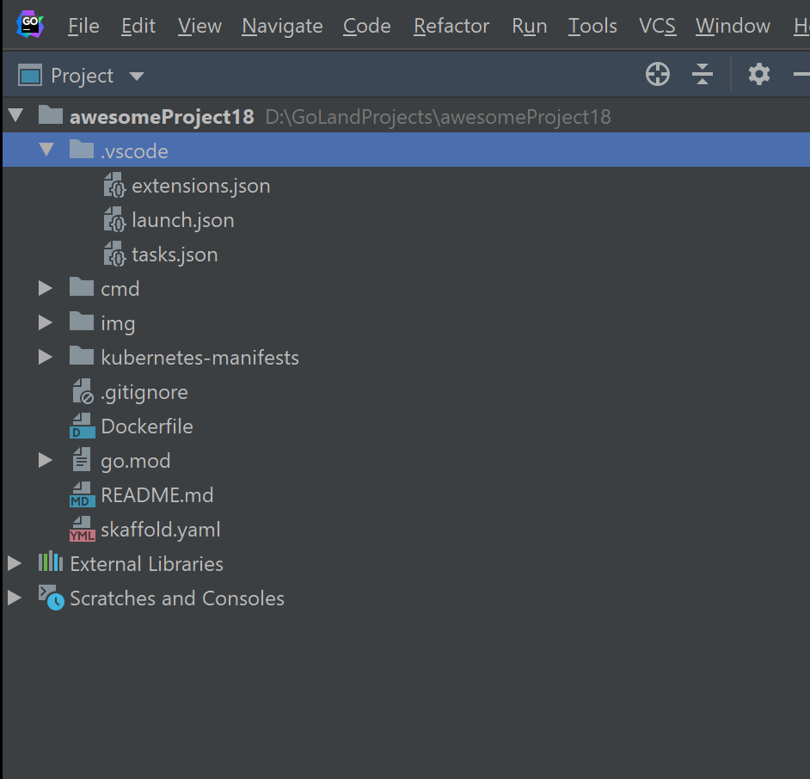
After Clone, you will get pop-up window asking Trust Project or not? Select Trust Project. Again, another window pop-up will come stating that open it in New Window or Existing window. Select New Window only. After that you will see the below model Window with Project path.

Slide 9
Open the path right click on it and go to Open with and click on Open with Explorer.
After opening the Location of Project, it contains only one folder showing as .idea only.
Now Keep that folder aside and open the Project which you had completed the code written folder with same Project name and copy src and pom.xml files from that Folder.
Paste those two copied files into the folder which contains only .idea folder in it.

Slide 10
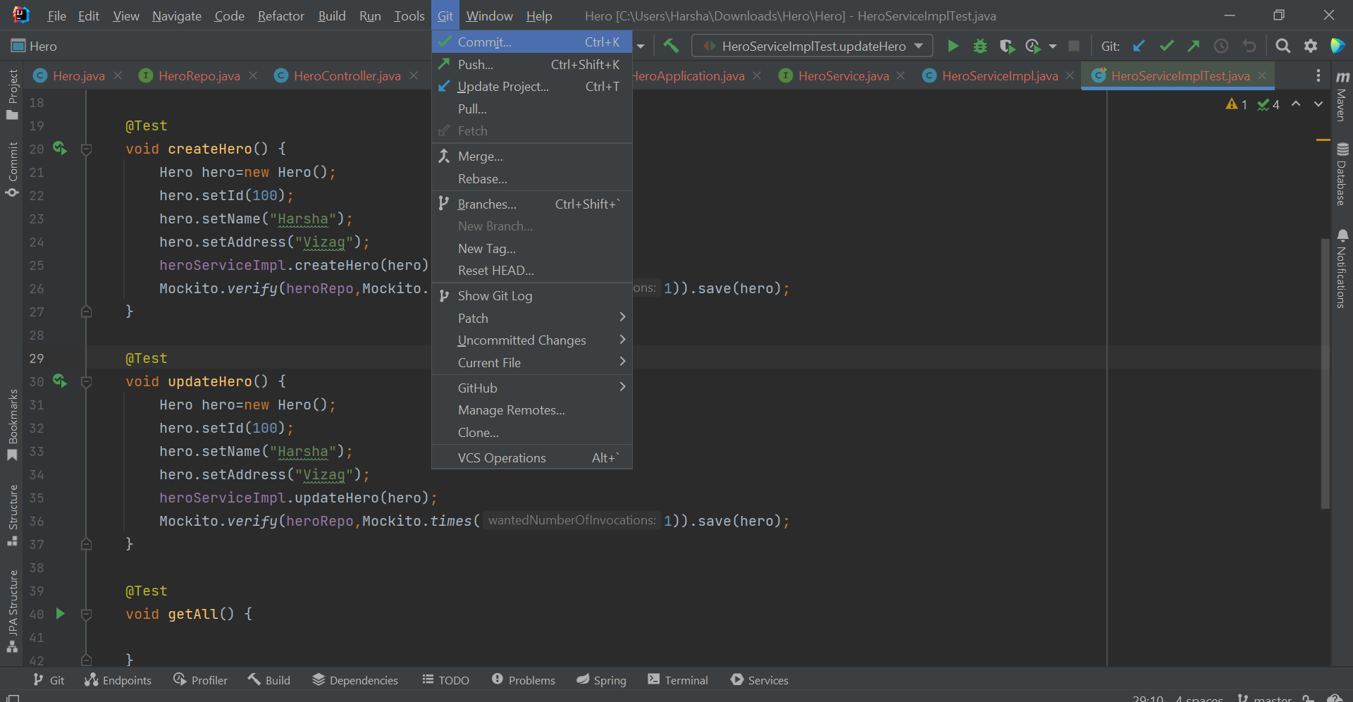
Then Go to Git In IntelliJ and right click on it and select Commit.

Slide 11
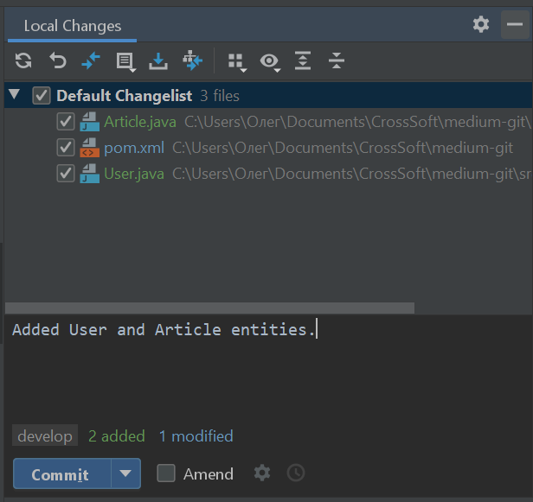
Select the Default Change list and add comment what changes or for what kind of program you had written code in brief and commit and commit anyway.

Slide 12
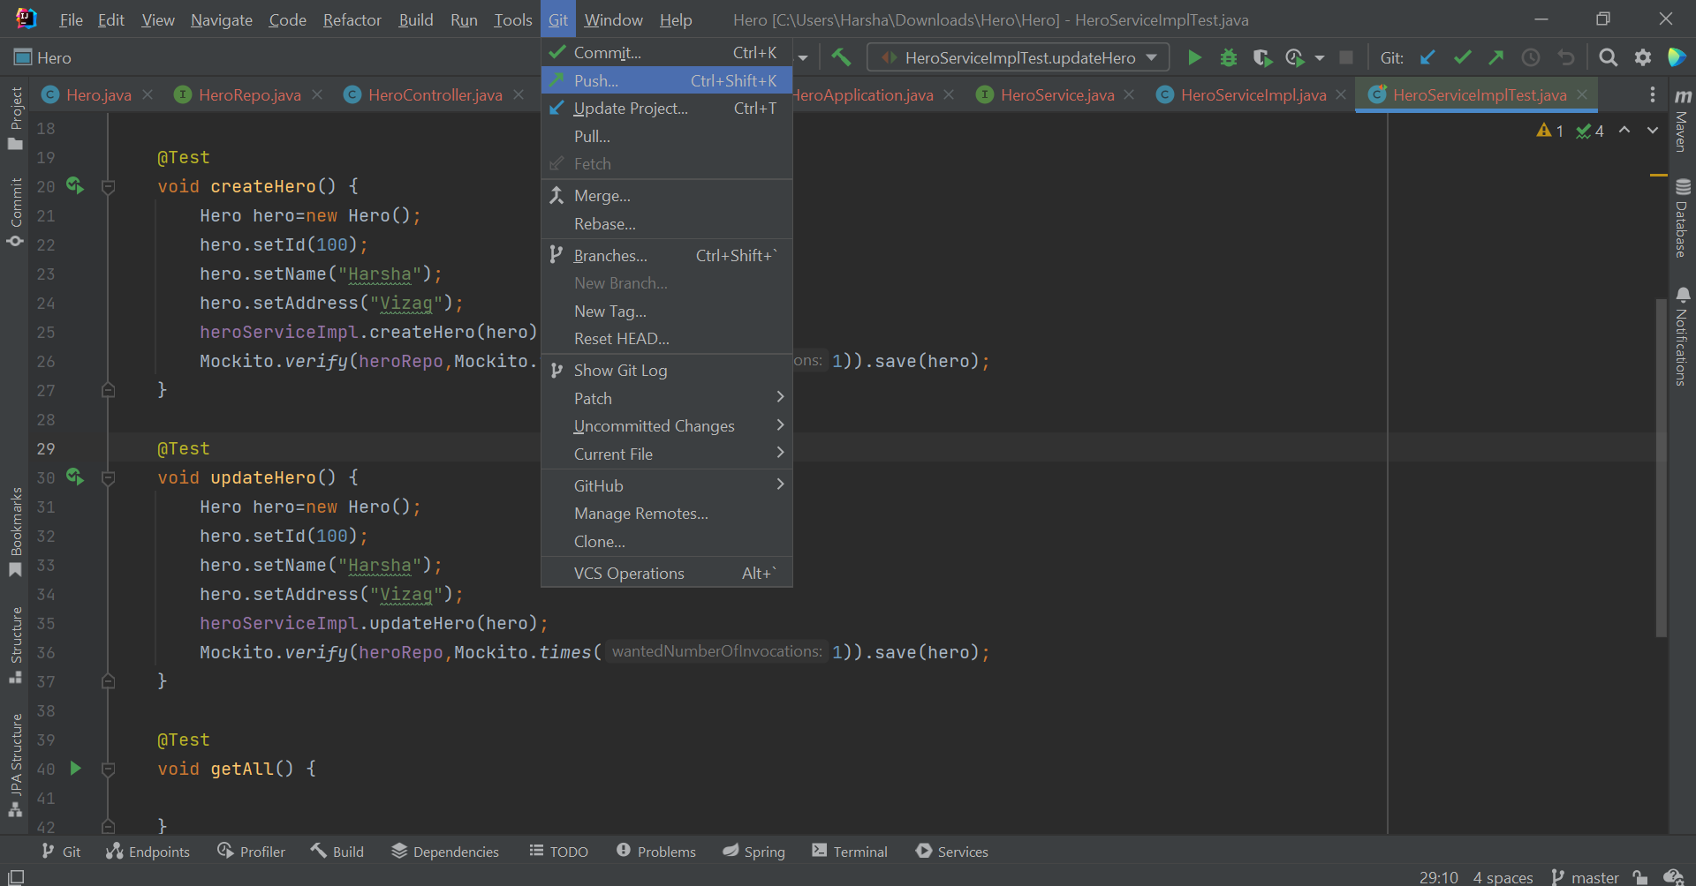
After commit, go to GIT in IntelliJ and Click on PUSH. The Complete Program which you are written code and executed Is pushed in to GITHUB.

Slide 13

After Pushing in to GITHUB, you can find the name of the Project which you have pushed through IntelliJ.

Slide 14
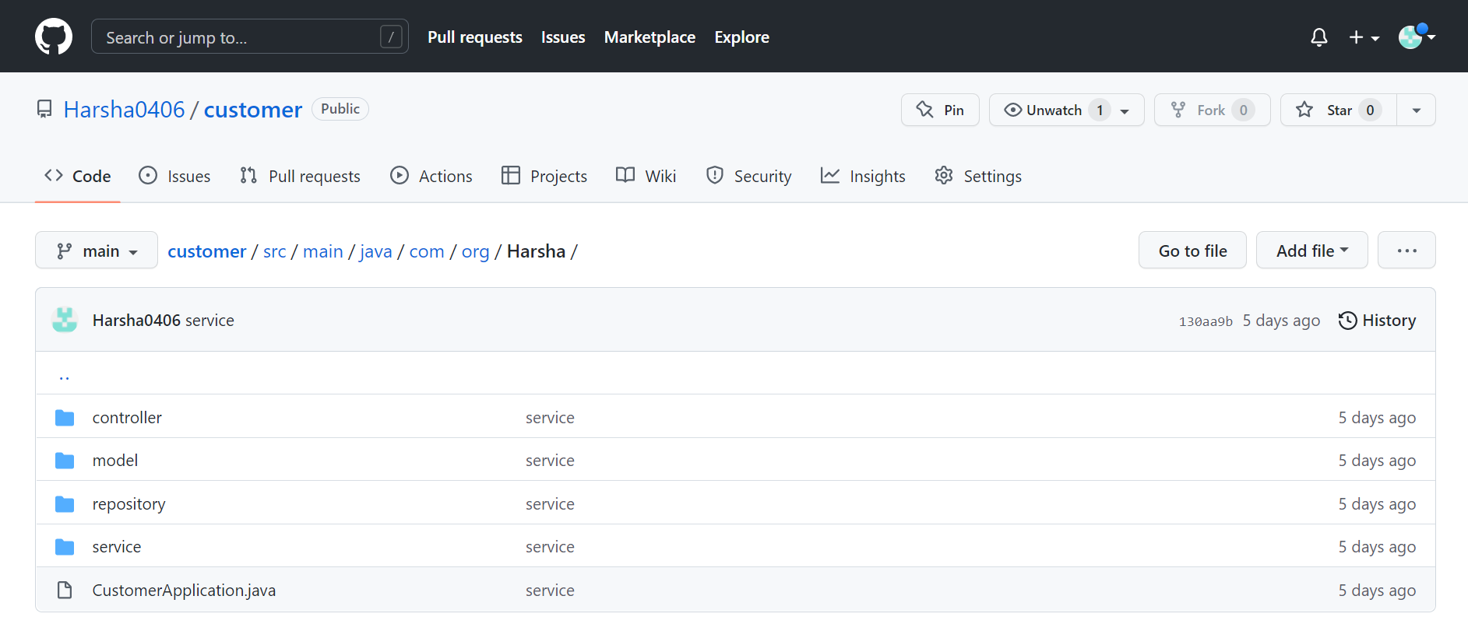
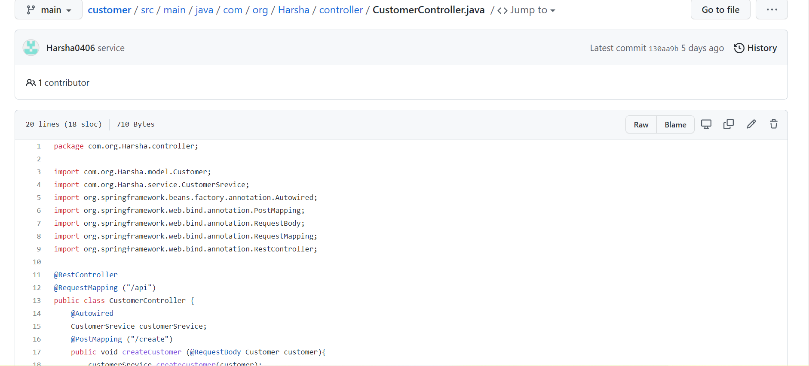
You can select the Name of the Project and We can see the all kinds of modules and methods which you used to run the program and inside those we can see the entire code in text format.

Slide 15
ANY QUERIES??? THANK YOU!

